Slide 1
DEX: A LAMP-STACK CONTACT MANAGER
USEFUL LINKS
GITHUB
LIVE WEBSITE
Notes:
10-15 seconds Introduce the project name and briefly state that it's a personal contact manager.
Mention the core technologies used (LAMP stack, AJAX, JSON, hosted on DigitalOcean).
Set the stage for what the audience can expect from the presentation.

Slide 2
TEAM MEMBERS – GROUP #29
Do, Thu — API/Front-End/
Lavadinho, Thomas — Database/Front-End
Rajashekar, Charanjith — Database/Front-End
Notes:
15 seconds
Introduce each team member and their specific roles in the project.
Highlight any collaboration efforts and how you worked together to bring different parts of the project to life.

Slide 3
OVERVIEW
• Provides a LAMP-stack solution for personal contact management.
• Allows users to register, log in, and maintain their own contacts (CRUD).
• Data is stored in MySQL; the front-end communicates via AJAX/JSON.
Notes:
45 seconds-char AJAX, which stands for Asynchronous JavaScript and XML, is a web development technique that allows web pages to update content without reloading the entire page.
This is achieved by using JavaScript to make asynchronous HTTP requests to a server, retrieving data and then updating specific parts of the page with the new content.
Explain the purpose of DigiDex: a simple and efficient way for users to manage personal contacts.
Mention the main features like user registration, login, adding, searching, editing, and deleting contacts.
Emphasize the real-time updates via AJAX calls.

Slide 4
TECHNOLOGIES STACK
LAMP components: Linux, Apache, MySQL, PHP
AJAX/JSON for Client ↔ Server calls
SwaggerHub for API docs (OpenAPI 3.0)
draw.io for ERD & Use-Case diagrams
Google Colab matplotlib for Gantt chart generation
DigitalOcean droplet (remote hosting)
Godaddy (domain registration)
GitHub (source control)
Discord + Apple iMessage (project communication)
Notes:
45 seconds-char
Explain the purpose of DigiDex: a simple and efficient way for users to manage personal contacts.
Mention the main features like user registration, login, adding, searching, editing, and deleting contacts.
Emphasize the real-time updates via AJAX calls.
Break down the LAMP stack components (Linux, Apache, MySQL, PHP) and why they were chosen.
Mention the use of AJAX for asynchronous communication and JSON for lightweight data exchange.
Talk about the benefits of using DigitalOcean for hosting
We chose LAMP because it’s a mature, well-documented environment.
Apache is reliable for serving PHP, and MySQL is widely supported for relational data.
JSON is lightweight, easy to parse in JavaScript, and works seamlessly with PHP’s json_encode/json_decode.

Slide 5
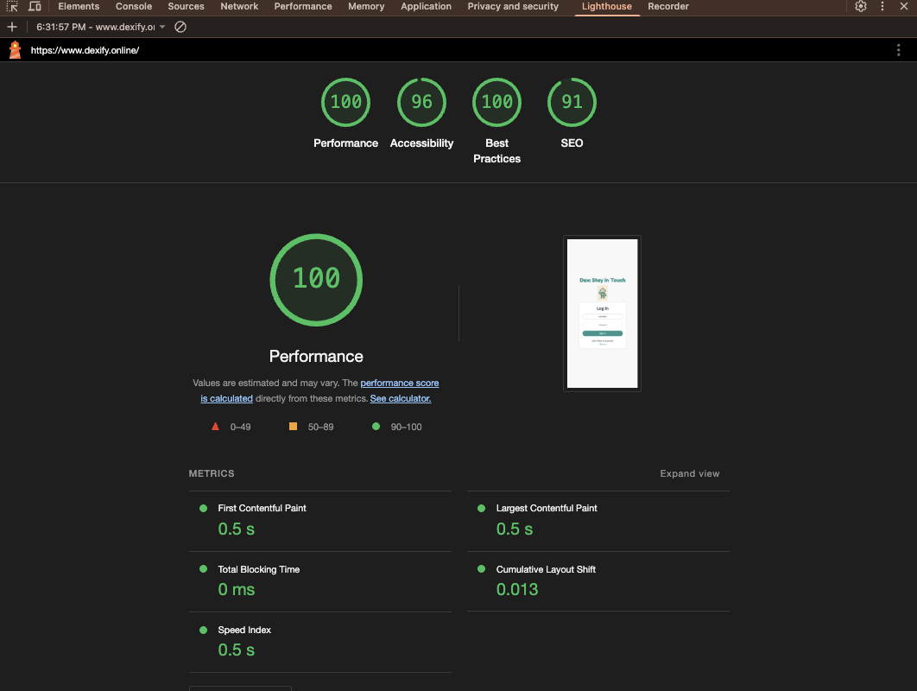
LIGHTHOUSE REPORT
Current Lighthouse Scores
• Performance: 100/100
• Accessibility: 96/100
• Best Practices: 100/100
• SEO: 91/100
Notes:
30 seconds
Why These Matter
• High performance → faster load times for users.
• Perfect accessibility → everyone can navigate easily.
• Strong best practices / SEO (search engine optimization) → better security and discoverability.
Present the Lighthouse scores and what they mean for performance, accessibility, best practices, and SEO.
mention any minor tweaks that could be made for a perfect score.
Highlight that the overall results show that app is well-optimized.

Slide 6
Potential Future Optimizations for Lighthouse
Improve Accessibility Score: Use background and foreground colors with higher contrast ratio to improve Accessibility score
Improve SEO score: Format HTML with meta descriptions
Notes:
30 seconds

Slide 7
WHAT WENT WELL & WHAT DIDN’T
What Went Well - Team Collaboration and communication
Adapting Deadlines to unexpected events
Making team based decisions like website design
What Didn’t Go Well
Learning curve first time using digital ocean, swaggerhub,
Brushing up on Css, Html, Js and PHP languages
Swaggerhub not properly leveraged to front-end and back-end
Bugs from connecting API to front-end
Notes:
1 min-thu

Slide 8
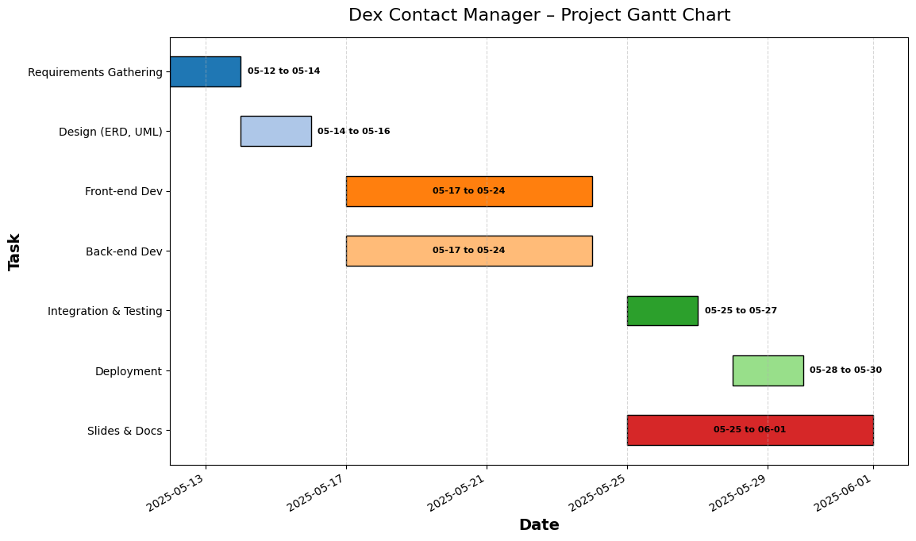
GANTT CHART
Project Phases:
Requirements Gathering → Design → Dev → Testing → Deployment → Slides + Documentation
Created by Thu Do with Google Colab (Matplotlib)
Notes:
45 seconds
Walk through the project timeline, mentioning key phases like requirements gathering, design, development, testing, and deployment.
Highlight any challenges in meeting deadlines and how you adjusted the schedule to stay on track.
Requirements Gathering (plot out features, design specs).
Design Phase (draw ERD, UML diagrams, planning).
Development (front-end and back-end in parallel).
Integration & Testing (unit/integration tests, bug fixes).
Deployment (server setup on DigitalOcean, DNS, domain).
Slides & Documentation (SwaggerHub, diagrams, PowerPoint).

Slide 9
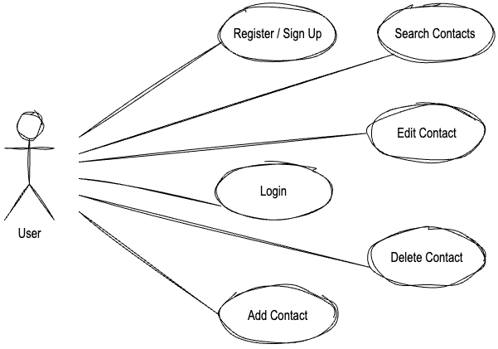
USE-CASE DIAGRAM
Created by Thu Do with draw.io
User can Register for an account, Log In, Add/Edit/Delete/Search Contacts.
Notes:
30 seconds-char
Explain the main user actions: registering, logging in, adding, searching, editing, and deleting contacts.
Emphasize how each use case represents a core functionality that the user would interact with.

Slide 10
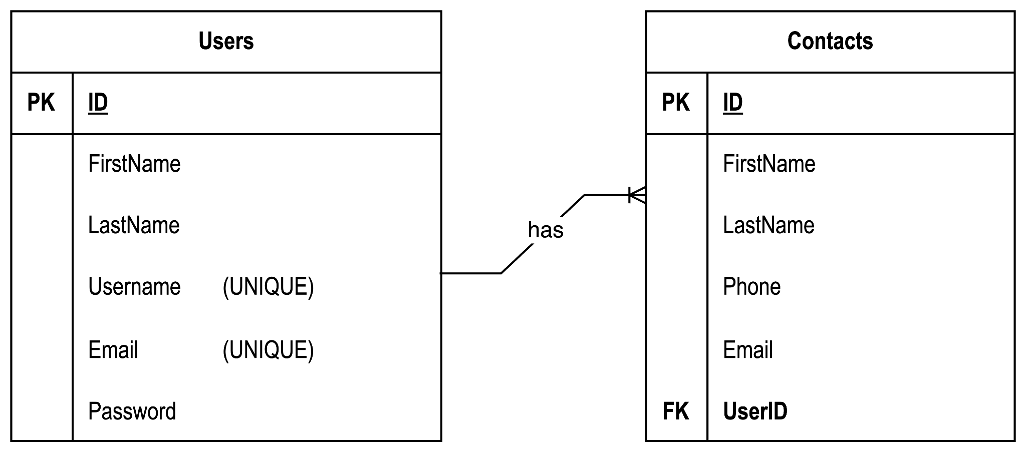
ENTITY RELATIONSHIP DIAGRAM (ERD)
Created by Thu Do with draw.io
Notes:
45 seconds Describe the relationship between the Users and Contacts tables.
Highlight important constraints like unique usernames and emails, and the foreign key linking contacts to users.
Explain how this structure ensures data integrity.
Unique Constraints: Username, Email must be unique to prevent duplicate accounts.
Primary Key: Ensures every row in a table is uniquely identifiable. In Users, ID lets us refer uniquely to each user when logging in or adding contacts.
Foreign Key: Enforces referential integrity—every Contacts.UserID must match an existing Users.ID. This prevents orphaned contacts that belong to no user.
Data Integrity: If a user is deleted (or updated), the database knows how to cascade or restrict related contacts.

Slide 11
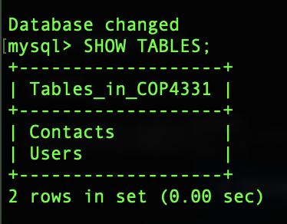
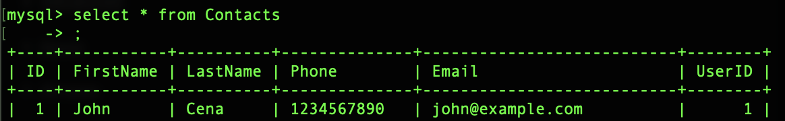
DATABASE SCHEMA & ER EXPLANATION****
Notes:
30 seconds-thomas
Very quickly recap tables: User, Contact
Highlight primary/foreign keys and why.
PK: ID ->
Foreign Key: UserID ->

Slide 12
API DEMONSTRATION (SWAGGERHUB)
+
LIVE DEMO
Notes:
Live demo continued within 1 min 30 Screen-share the SwaggerHub page showing at least one endpoint (e.g. POST /api/contacts/search).
Show example JSON request (e.g. {"query":"John"}) and response (200 OK + array of matching contacts).
Mention that every API call returns JSON.

Slide 13
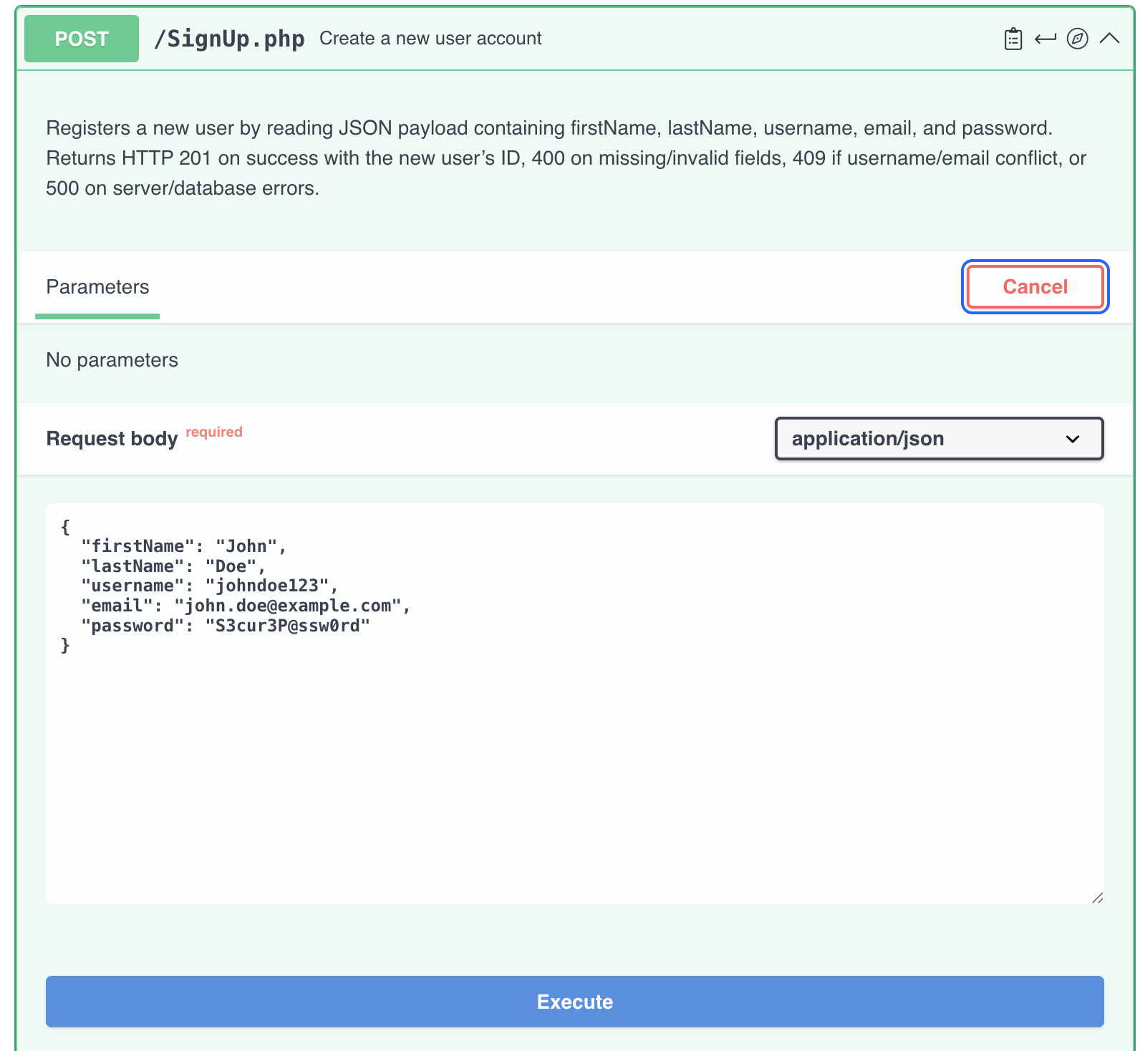
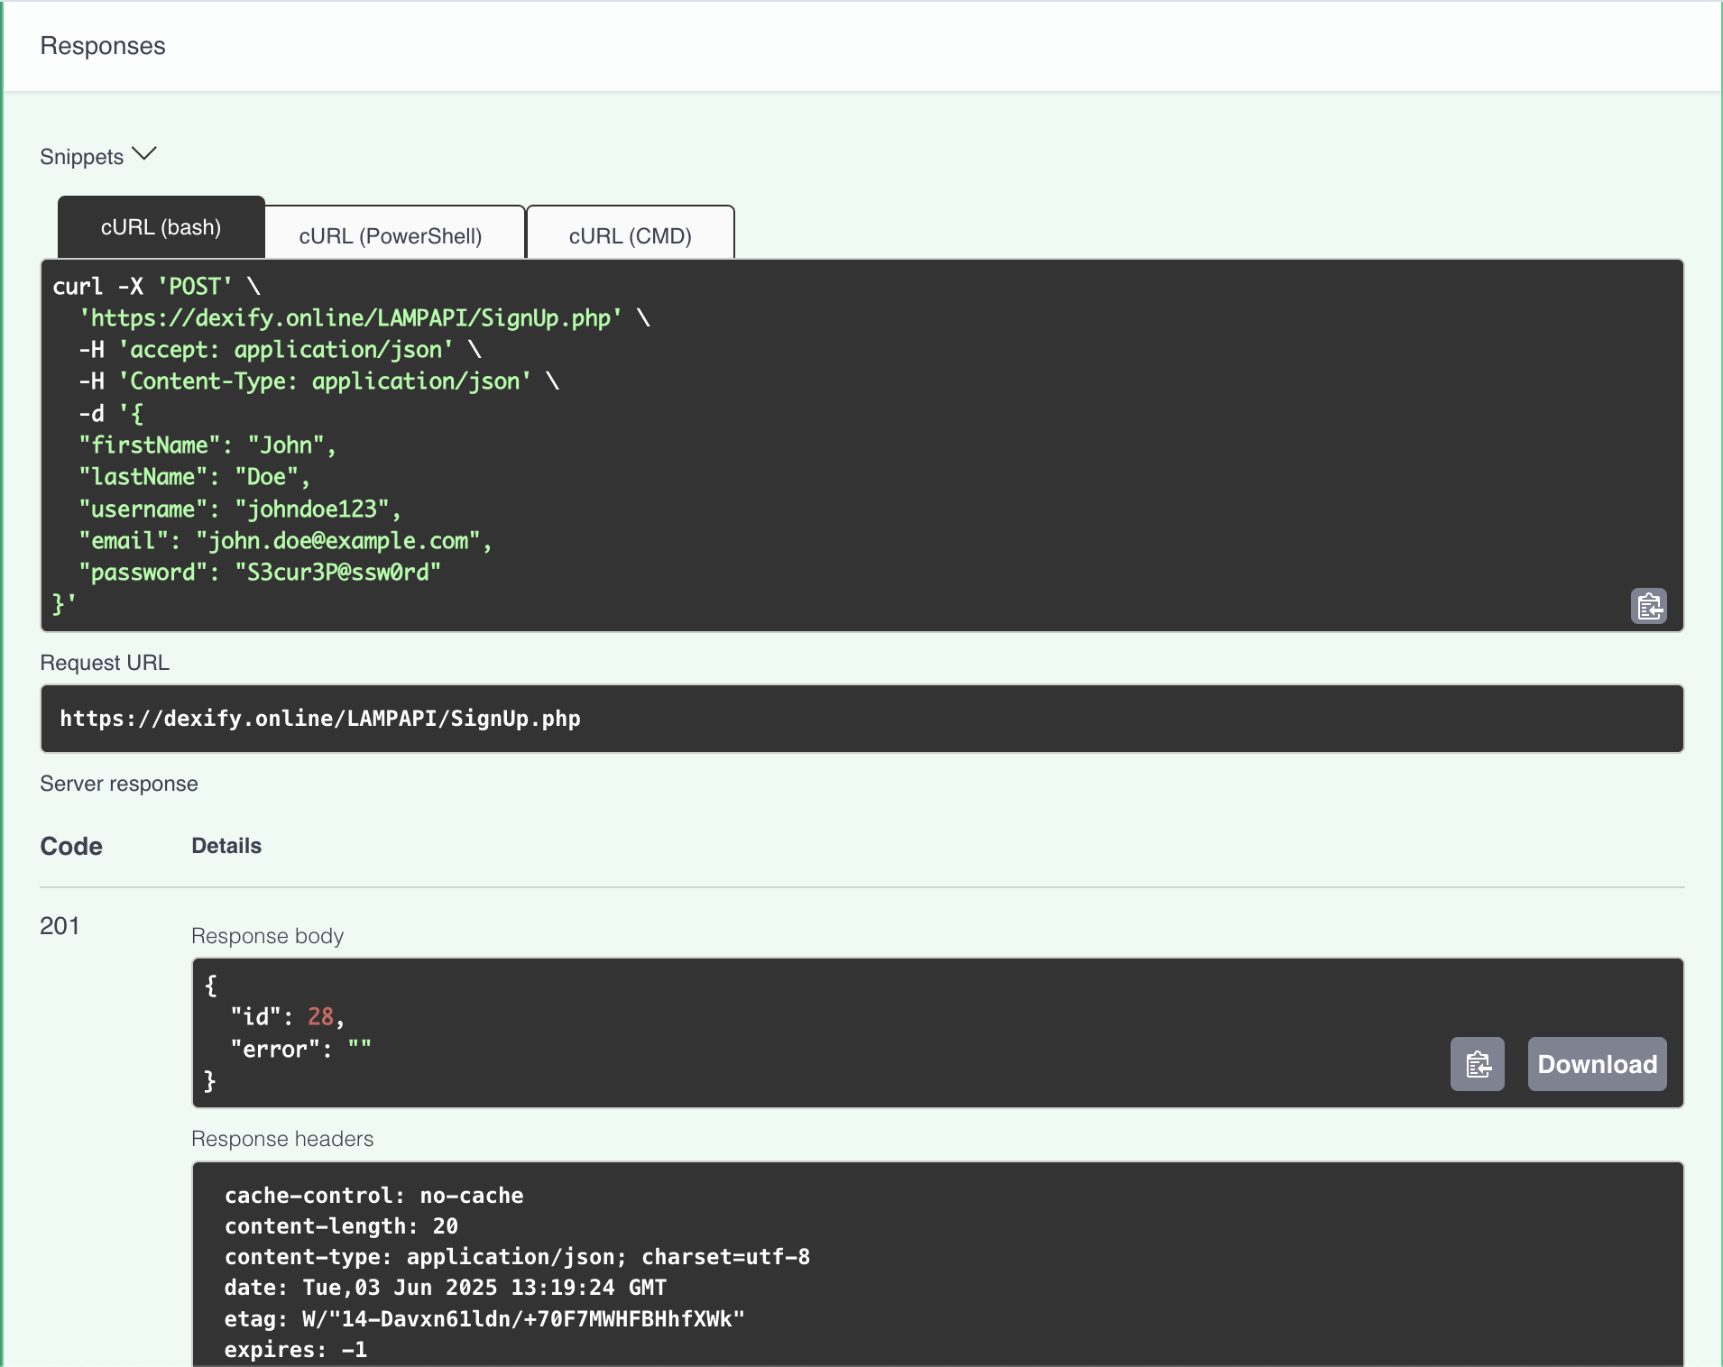
Notes:
Live demo continued within 1 min 30 Screen-share the SwaggerHub page showing at least one endpoint (e.g. POST /api/contacts/search).
Show example JSON request (e.g. {"query":"John"}) and response (200 OK + array of matching contacts).
Mention that every API call returns JSON.

Slide 14
• POST /Signup.php
– Request JSON: { firstName, lastName, username, email, password }
– Success (201): { id, error: "" }
– Errors: 400 if missing/invalid; 409 if username/email exists
• POST /Login.php
– Request JSON: { username, password }
– Success (200): { id, firstName, lastName, error: "" }
– Errors: 400 if missing; 401 if invalid password; 404 if user not found
POST /AddContact.php
– Request JSON: { FirstName, LastName, Phone, Email }
– Success (201): { contactId, error: "" }
– Error: 400 if missing fields
• GET /SearchContacts.php?query={term}
– Returns (200): [ { ID, FirstName, LastName, Phone, Email }, … ]
– 204 if no matches
• PUT /EditContact.php
– Request JSON: { ID, FirstName, LastName, Phone, Email }
– Success (200): { message: "Contact updated" }
– 404 if contact not found
• DELETE /DeleteContact.php?id={ID}
– Success (200): { message: "Contact deleted" }
– 404 if not found

Slide 15
Go to for Dex’s SwaggerHub API for a live demo:
Dex: Swaggerhub API Link
Notes:
Live demo continued within 1 min 30 Screen-share the SwaggerHub page showing at least one endpoint (e.g. POST /api/contacts/search).
Show example JSON request (e.g. {"query":"John"}) and response (200 OK + array of matching contacts).
Mention that every API call returns JSON.

Slide 16
APPLICATION DEMO
Login/Signup: Show sign-up page, create a new user.
Add Contact: Fill out and submit.
Search Contact: Show partial match search (e.g. type “Jo” lists “John Doe”).
Edit/Delete Contact: Modify a field, save; then delete and confirm removal.
Emphasize that contacts are never pre-fetched—all searches go to the API.****
Notes:
3 min Sign Up
Navigate to the “Sign Up” page.
Enter First Name, Last Name, Username, Email, Password.
Click “Submit”.
Observe response: API call to /Signup.php returns { "id": <newID>, "error": "" }.
Confirm you see a success message or are redirected to login.
Log In
Go to the “Log In” page.
Enter the same Username and Password you just created.
Click “Log In”.
API call to /Login.php returns { "id": <userID>, "firstName": "…", "lastName": "…", "error": "" }.
You are redirected to the main “Contacts” interface.
Add Contact
On the “Contacts” dashboard, click “Add Contact”.
Fill out First Name, Last Name, Phone, Email.
Press “Save”.
AJAX POST to /AddContact.php returns { "contactId": <newContactID>, "error": "" }.
Verify the new contact appears in your contacts list immediately.
Search Contact
In the search field, type a partial string (e.g., “Jo”).
Press “Search” or wait for keyup.
AJAX GET to /SearchContacts.php?query=Jo returns a JSON array of matching contacts.
Confirm the matching contact(s) appear dynamically—no page reload.
Edit Contact
Next to a listed contact, click “Edit”.
Change one field (e.g., update phone number).
Click “Save”.
AJAX PUT to /EditContact.php with JSON { ID, FirstName, LastName, Phone, Email } returns { "message": "Contact updated" }.
Verify the contact’s details update in place.
Delete Contact
Next to a contact, click “Delete”.
Confirm the prompt.
AJAX DELETE to /DeleteContact.php?id=<ID> returns { "message": "Contact deleted" }.
Verify the contact disappears from the list.

Slide 17
QUESTIONS
Q&A
Notes:
15 sec intro + time for students/prof to ask questions “Any questions?”

Slide 18
Thank you!

